Slide 1
ELEMENTARY STATISTICS, BLUMAN
Sample Standard Deviation
© 2019 McGraw-Hill Education. All rights reserved. Authorized only for instructor use in the classroom. No reproduction or further distribution permitted without the prior written consent of McGraw-Hill Education.

Slide 2
Objectives for this PowerPoint
Learn how to calculate the sample standard deviation

Slide 3
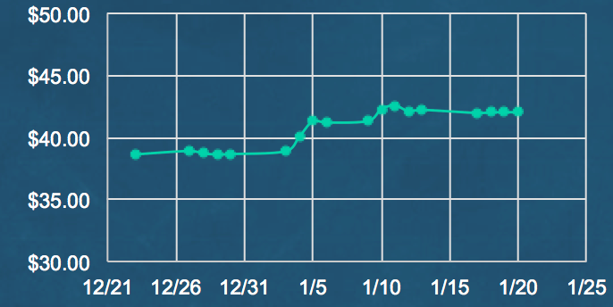
Company A
Here is a time series chart that shows the adjusted closing stock price for a company we will call Company A for a sample of 18 days. The sample mean for the data is $40.77.

Slide 4
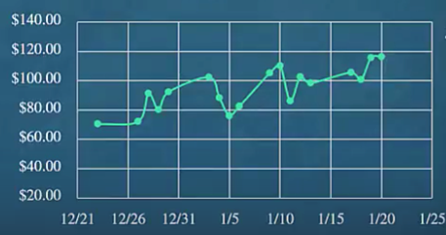
Company B
This is a similar graph for another company that we will call Company B. The sample mean for the data is $94.34.

Slide 5
Purpose of Standard Deviation
There are many factors to consider when choosing an appropriate stock for investment purposes. One of the measures that aids in this decision process is the standard deviation. Recall that the standard deviation is a measure of how spread out the data values are. Both of these stocks appear to have an upward trend in their stock price, but Company B appears to have more variation in its stock price. This variation can influence a decision with regard to risk. In many cases, an older investor would be less likely to be willing to incur high risk in an investment than a younger person.

Slide 6

Sample Variance Formula
The formula for the sample variance is similar to the formula for the population variance with the exception of the denominator. Note that the formula calls for us to subtract 1 from the sample size. This is done in order to overcome the tendency to underestimate the population variance when using a sample as a representative data set.
$$s2=\frac{\sum{\left(x−\overline{x}\right)2}}{n−1}$$

Slide 7

Sample Standard Deviation
Note the use of the letter s as the symbol for the sample standard deviation.
$$s=\sqrt{s^{2}}$$

Slide 8
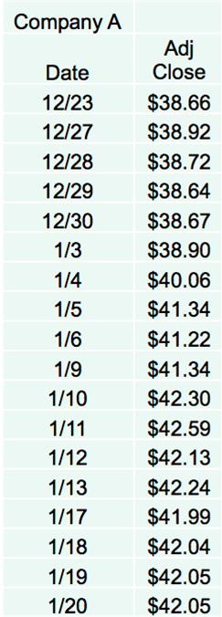
Data for Company A
Note that the formula shows that we will need to subtract the sample mean from each data value.
These are called the deviations from the mean. The mean for this data set is $40.77. Once we subtract the mean from each data value we will then need to square the value.
(38.66 – 40.77)² = 4.4521
(38.92 – 40.77)² = 3.4225
Continue through all data points
The next slide shows the completed table.

Slide 9
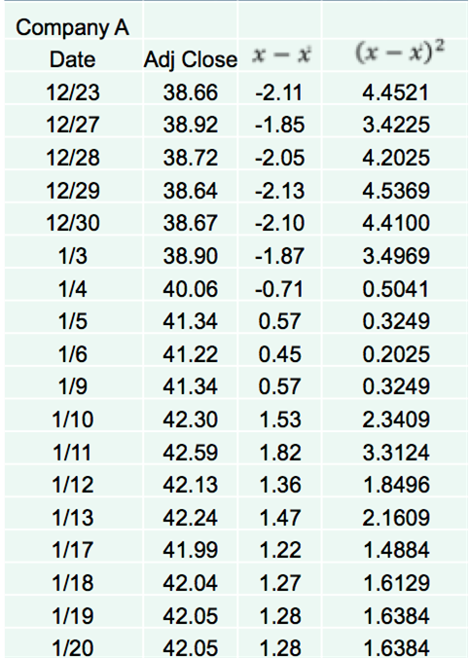
Company A – Completed Table

Slide 10

Calculate Variance for Company A
Before we can use the formula for sample variance we need to sum all of the values in the last column on the previous slide.
$$\sum{\left(x−\overline{x}\right)2}=41.9192$$
$$s2=\frac{\sum{\left(x−\overline{x}\right)2}}{n−1}$$
$$s2=\frac{41.9192}{18−1}=2.465835294$$
The rounding rule for the standard deviation is to round to one more decimal place than occurs in the raw data.

Slide 11

Standard Deviation for Company A
$$s=\sqrt{s^{2}}$$
$$s=\sqrt{2.465835294}=1.570$$
The rounding rule for the standard deviation is to round to one more decimal place than occurs in the raw data.

Slide 12
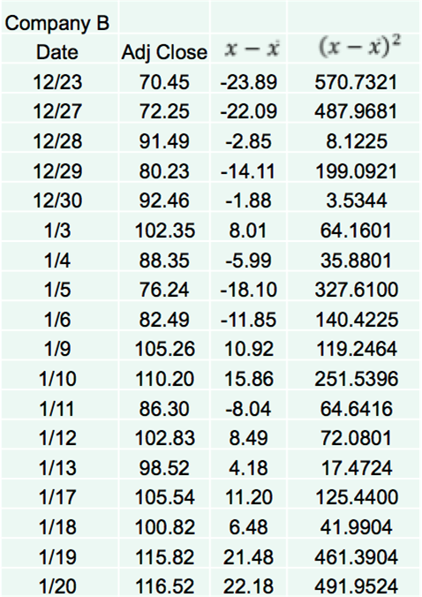
Completed Table for Company B

Slide 13

Variance for Company B
$$\overline{x}=\$94.34$$
$$s2=\frac{\sum{\left(x−\overline{x}\right)2}}{n−1}$$
$$\sum{\left(x−\overline{x}\right)2}=3483.2752$$
$$s2=\frac{3483.2752}{18−1}=204.8985412$$

Slide 14

Standard Deviation for Company B
$$s=\sqrt{s^{2}}$$
$$s=\sqrt{204.8985412}=14.314$$

Slide 15

Company A Adjusted Closing Stock Price
$$\overline{x}=\$40.77$$
$$s=1.570$$

Slide 16


Company B Adjusted Closing Stock Price
$\overline{x}=94.34$
$$s=14.314$$

Slide 17
Comparison of Graphs
Looking at the graphs, we see that the differences in the amount of variation within the data sets is reflected in the sample standard deviations.

Slide 18
Summary
In this PowerPoint we learned how to calculate the sample standard deviation

